Slide 1
Environmental Links to Health Outcomes in Rwanda and Tanzania
Vishali Sairam & Jean Pierre Salendres

Slide 2
TABLE OF CONTENTS
01
04
02
05
03
Background
Experiments & Analysis
Related Work
Conclusions
Methods

Slide 3
BACKGROUND
Going beyond the traditional urban-rural dichotomy
II. To predict specific health outcomes
Peri-urban areas
1. Look at individual’s household environment
i.e. access to water and sanitation, roof and house building materials, etc.
Large cities
Small towns
2. Look at immediate external environment conditions
i.e. temperatures, land crop potential,, precipitation, nighttime luminosity, etc.
Rural outposts
Medium villages

Slide 4
RELATED WORK
- Djikstra et al (2018) developed a new measure of urbanization using spatial data and differential measures of population grid to show that population share in rural areas are radically different in many Asian and African countries
- Applications of satellite sensing to study economic well-being and poverty in Africa Georganos et al (2019)
- Night-time luminosity data in studies about poverty and economic development Chen and Nordhaus (2011) and Bruederle (2018).
- Link between environmental change and urbanization to specific health outcomes across Africa and Asia. Montgomery (2008)
- Uses 85 Demographic and Health Surveys to find neighborhoods of poor households are more heterogeneous than is often asserted.

Slide 5
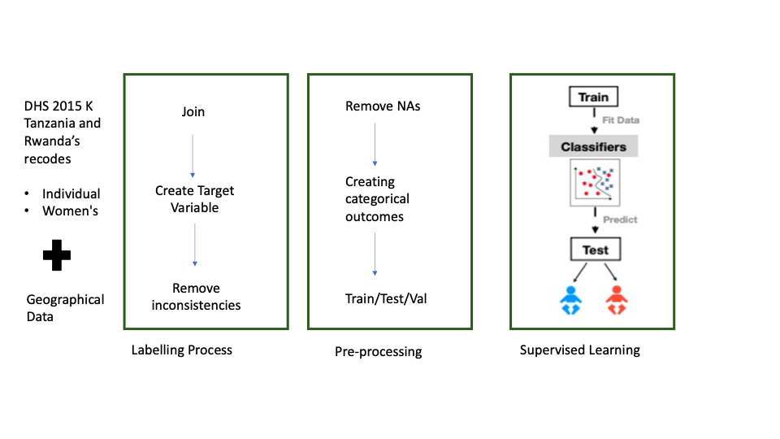
EXPERIMENT & DATA
Maternal Health Outcome Prediction
Anemia Test as measure
Which Machine Learning Algorithm helps us best predict outcomes using environment independent variables from DHS data
Two types: external environment vs. built-environment
Child Health Outcome Prediction
Standard Deviation underweight/ height variable as measure

Slide 6
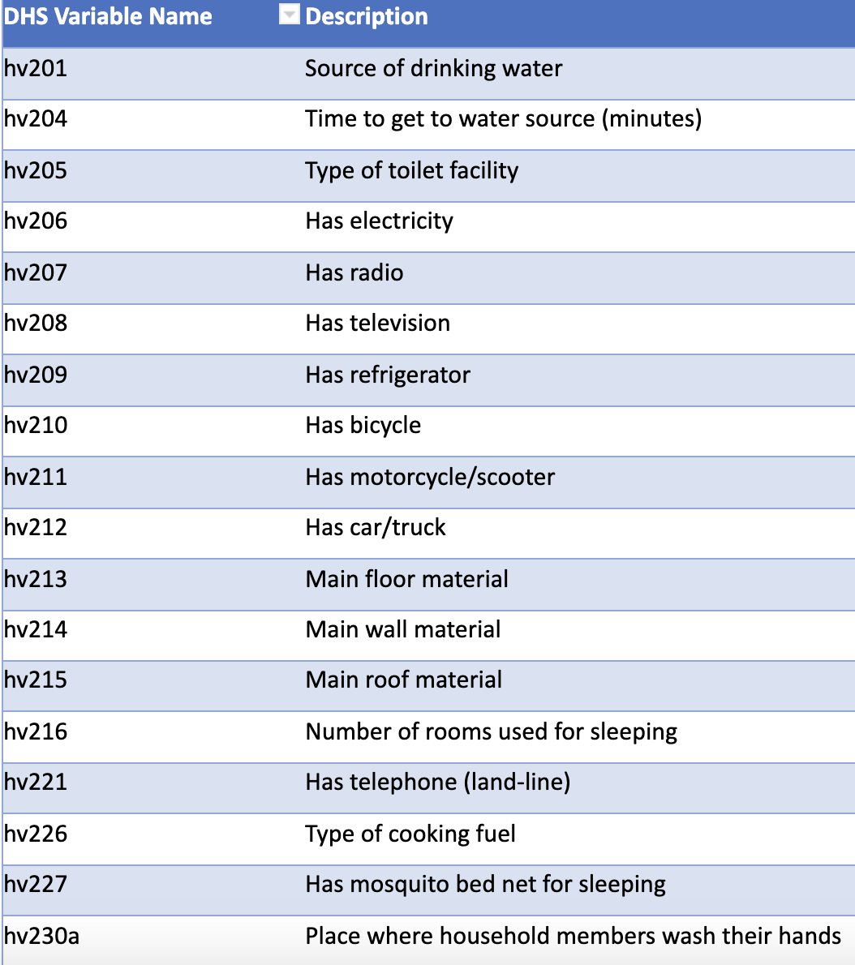
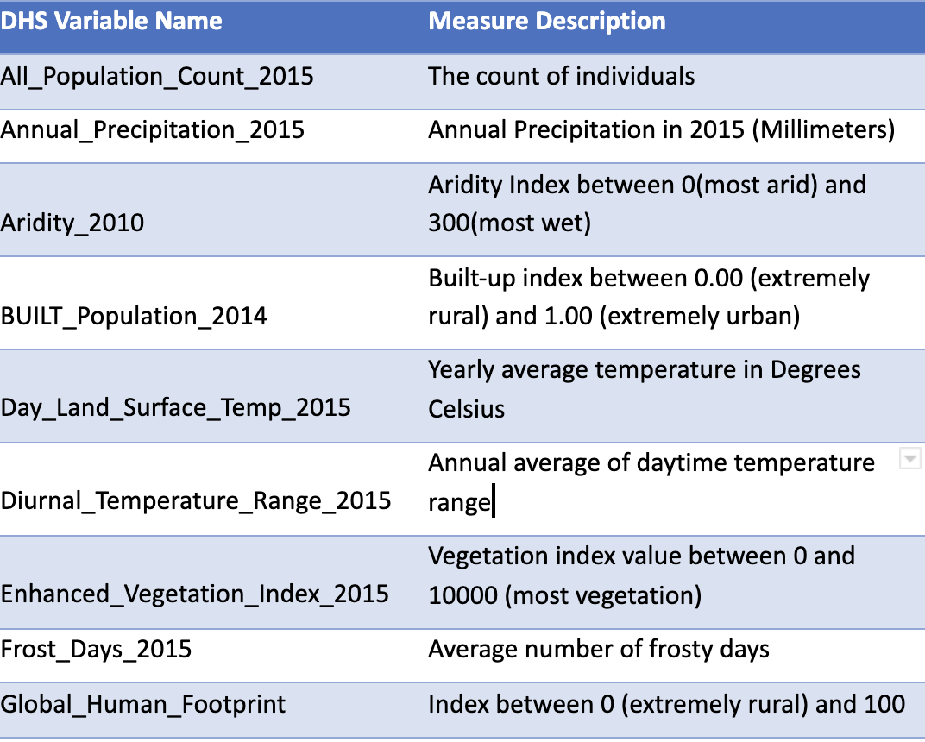
INDEPENDENT VARIABLES
Built-Environment variables
External Environment variables

Slide 7
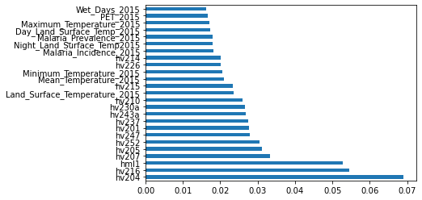
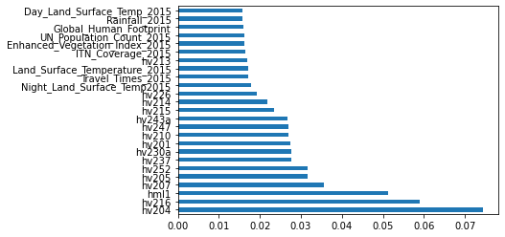
FEATURE SELECTION
Table I. Anemia - Top 20 Feature Selection
Built-Environment Variables predicting ha57 (anemia)
Built-Environment Variables predicting hc11 (malnutrition)
Table II. Malnutrition - Top 20 Feature Selection
External-Environment Variables predicting hc11 (malnutrition)
External-Environment Variables predicting ha57 (anemia)

Slide 8
METHODS
Logistic Regression
RANDOM FOREST
( Baseline) LR typically used to analyze binary data and is commonly used as an inferential tool and binary classification model in population health research
Use multiple algorithms to decide to split a node into two or more sub-nodes which are more homogenous in nature.
SVM
DECISION TREES
Generally work best with categorical variables, and hence might be less suited to our case which consist of both categorical and continuous.
Finds an optimal boundary between the possible outputs by transforming the data

Slide 9
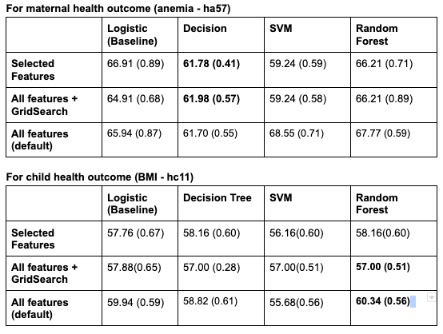
ANALYSIS
Classification Methods
Defining a Binary Outcome Variable
Feature Importance
Accuracy Rates vs False Negative Rates
Precision - Recall tradeoff
PCA analysis

Slide 10
CONCLUSIONS
I. Built-Environment > External Environment at predicting both health outcomes
II. Tradeoff between higher accuracy and false negative rates
III. Decision trees are a better choice for anaemia, random forests seem to be a better fit for malnutrition.
I. Limitations: dependent variables maternal anemia and child malnutrition.
II. Future area of work: Unsupervised machine learning models

Slide 11
MAIN REFERENCES
Beluzo, Carlos Eduardo, et al. Machine Learning to Predict Neonatal Mortality Using Public Health Data from Sao Paulo - Brazil. doi:https://doi.org/10.1101/2020.06.19.20112953.
Bruederle, A., Hodler, R. (2018). Nighttime lights as a proxy for human development at the local level. PloS one, 13(9), e0202231. https://doi.org/10.1371/journal.pone.0202231
Lee, Jennifer, et al. “Predicting Mortality Risk for Preterm Infants Using Random Forest.” Scientific Reports, vol. 11, no. 1, Mar. 2021, p. 7308. www.nature.com, doi:10.1038/s41598-021-86748-4.

Slide 12
THANKS!
Any Questions?

